Slide 1
Risk & Risk Analysis
DAEN 459 - Capstone Senior Design Planning

Slide 2
Why Risk Matters
The potential for an undesired event or outcome due to uncertainty
Projects don’t fail because of risk, they fail due to mishandling
Risk is underestimated early, overcorrected later

Slide 3
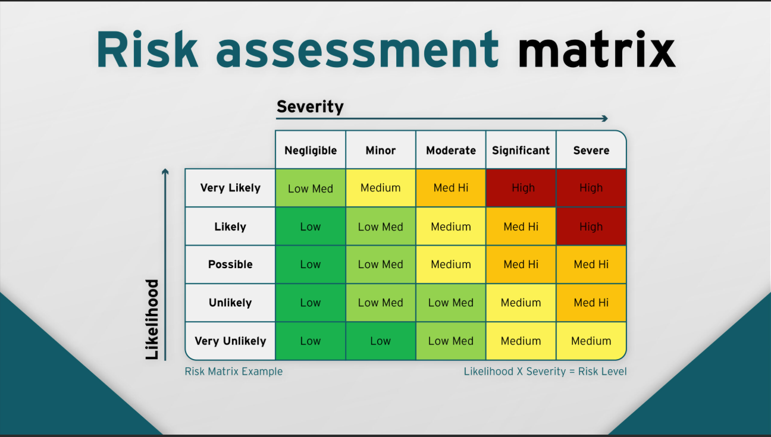
Risk = Likelihood x Consequence
Likelihood - Probability an unwanted event occurs
Consequence - Severity of impact if the event occurs
Used to quantify severity of risk

Slide 4
Types of Risk
Data Quality (incomplete or noisy data)
Technical (Tool failure or bugs in the code)
Analytical (Incorrect assumptions)
Scheduling Risk (Underestimating time to complete different stages)
Communication (Misalignment between stakeholder expectations and results)

Slide 5
Risk Mitigations
Data Quality - Validation scripts, schema control, version control
Technical - Automated testing and logging, modularize code
Analytical - Document assumptions, exploratory data analysis
Schedule - Track progress, build buffers into timelines
Communication - Use non-technical summaries, regular meetings with stakeholder

Slide 6
Risk Lifecycle
Identify
Analyze (probability x impact)
Mitigate (develop response plans)
Monitor
Communicate (update stakeholders)
This process is cyclical

Slide 7

Experience at the MITRE Corporation
Build MILP model for fuel logistics optimization
Systemic risks not just coding ones
Comprehensive testing suite to minimize risk
Don’t just build point solutions, think about downstream effects

Slide 8
Experience at the MITRE Corporation
Data Quality
Incomplete or classified supplier data
Look for ownership sources/data. Acknowledge gaps in report and data sources used
Technical
Incorrect objective/energy function formulation
Simplified pilot regions to test layout
Analytical
Blindly trusting solver and program outputs
Manually check constraints to ensure proper model formulation

Slide 9
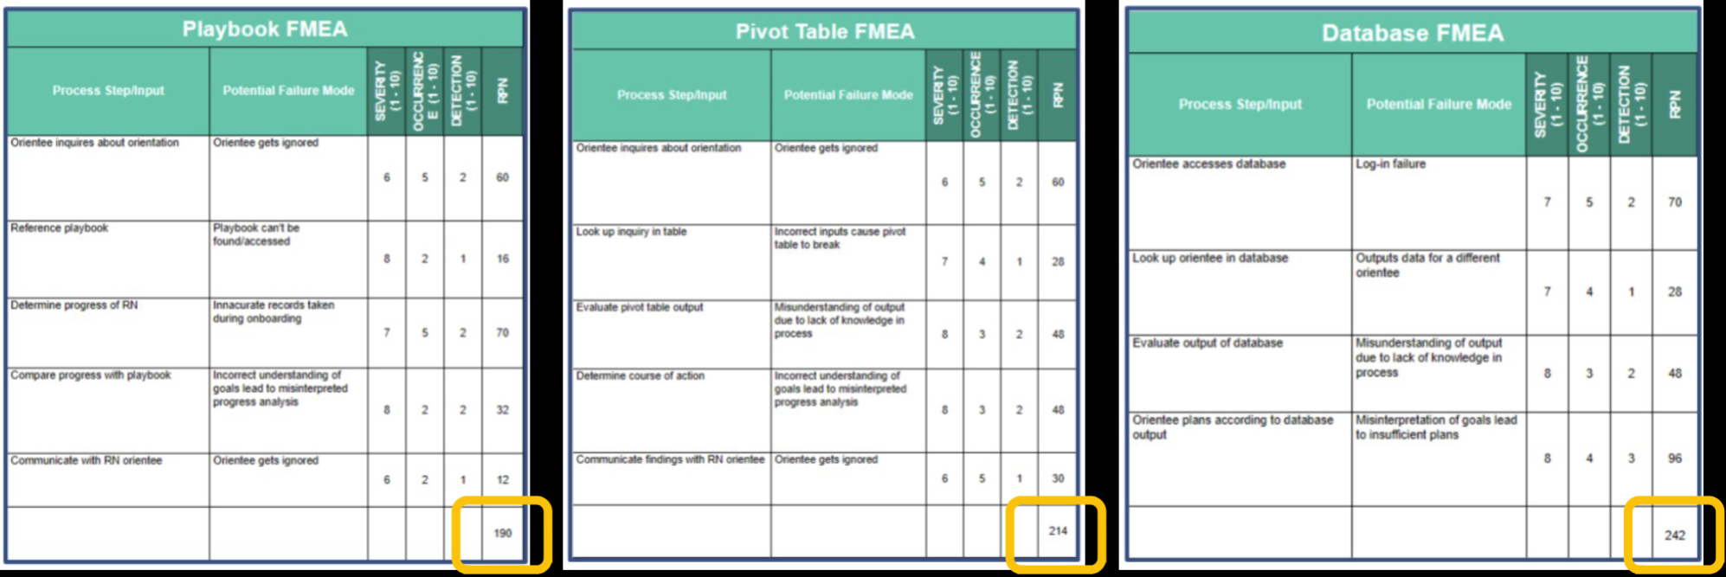
Risk Analysis

Slide 10
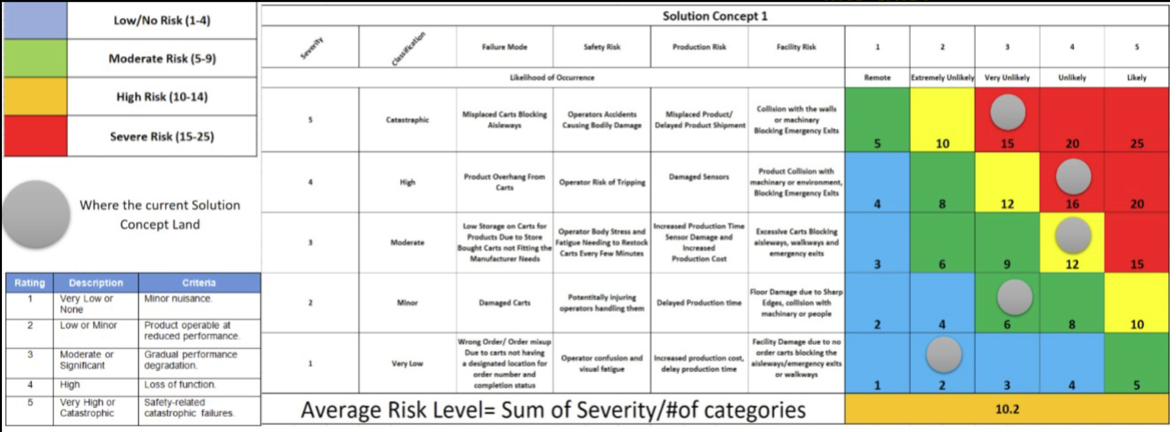
Risk Analysis

Slide 11
Communicating Risk
Risk is always present so there is nothing to be worried about!
Track residual risk closest and present this to stakeholders
Make sure they accept that this risk will be present in the system
Prioritize by impact
Document

Slide 12
What Have We Learned?
Anticipate uncertainty
Always consider edge cases
Document any and all assumptions
Constantly test and validate
Properly communicate with stakeholders

